Slide 1
Classification of COVID-19 from chest X-ray images using Deep Neural Networks
Presenter: DAO THI TRUC LOAN
JULY 26, 2022

Slide 2
Summary
 | Lung Segmentation task | Covid-19 Classification task
Dataset | COVID_QU_Ex | COVIDx CXR3
Model | FPN (DenseNet121) pretrained on ImageNet | ResNet152 pretrained on ImageNet
Loss | Combo loss: Dice + BCE + Focal | Cross Entropy Loss
Result | IoU: Dice score: | Precision: Recall: F1: Accuracy:

Slide 3
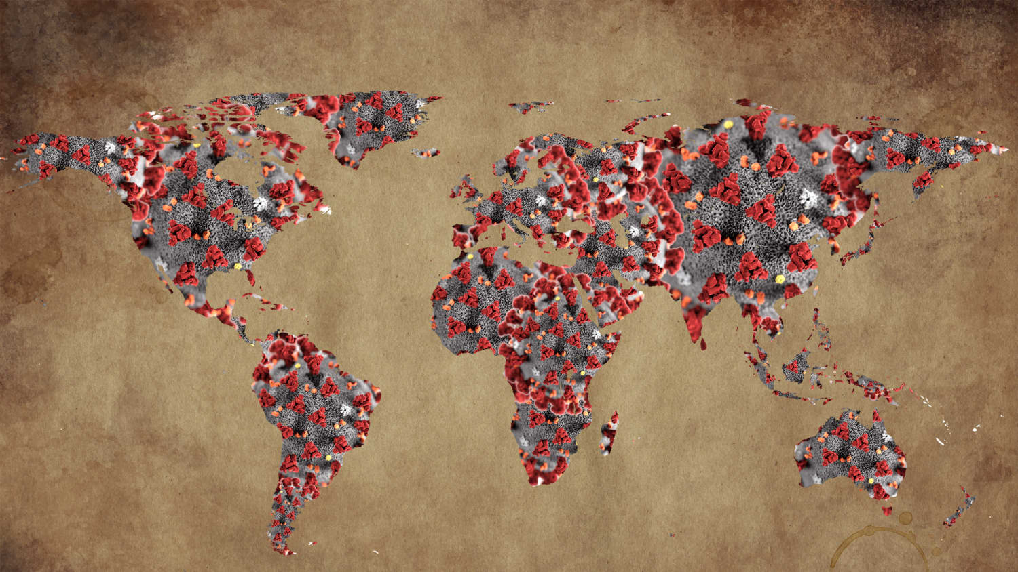
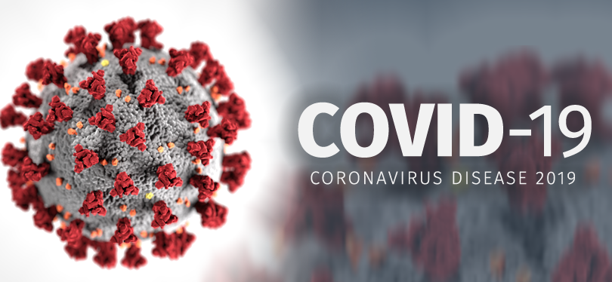
Background
COVID-19 was first reported in late 2019 in Wuhan, China, and has since spread throughout China and around the world, poses a serious threat to global public health.
3

Slide 4
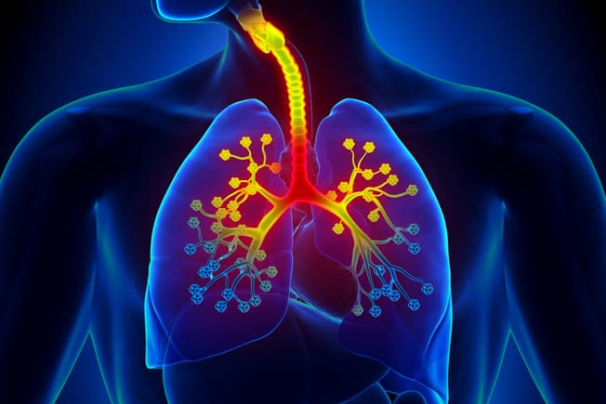
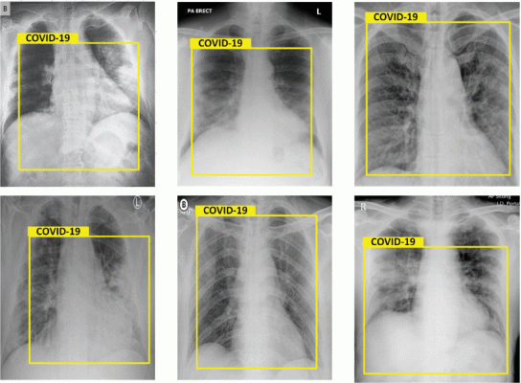
Background
COVID-19 is a respiratory disease, one that especially reaches into your respiratory tract, which includes your lungs.
Doctors can see signs of respiratory inflammation on a chest X-ray or CT scan.
https://www.webmd.com/lung/ss/slideshow-signs-had-covid
Results of chest X-Rays, detected as Covid-19. Images courtesy of IEEE
4

Slide 5
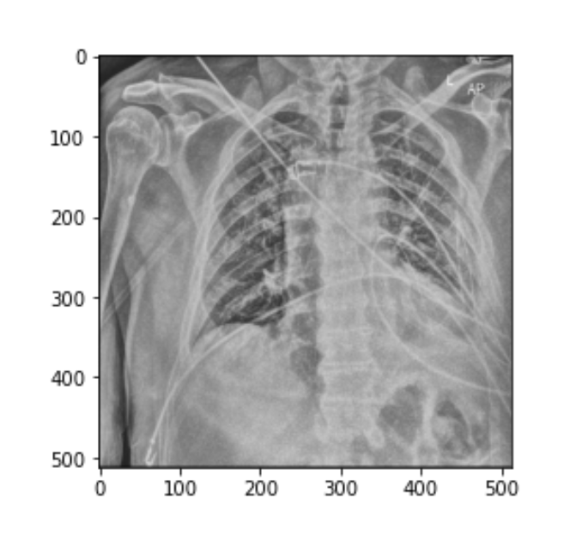

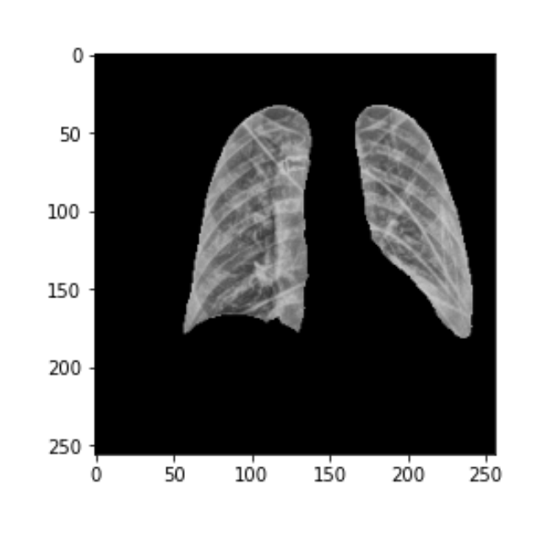
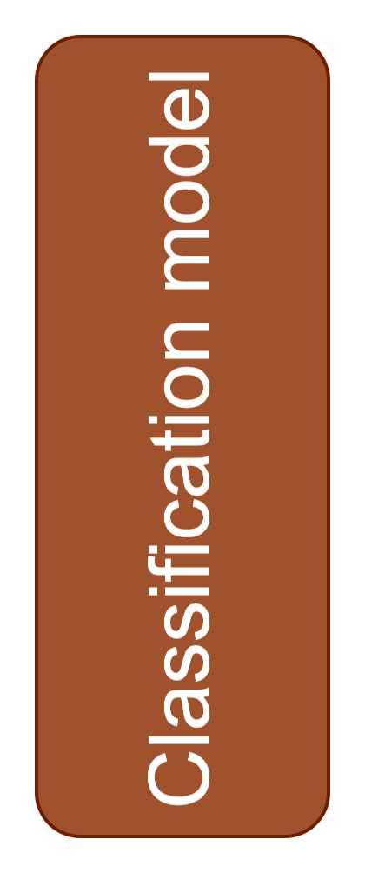
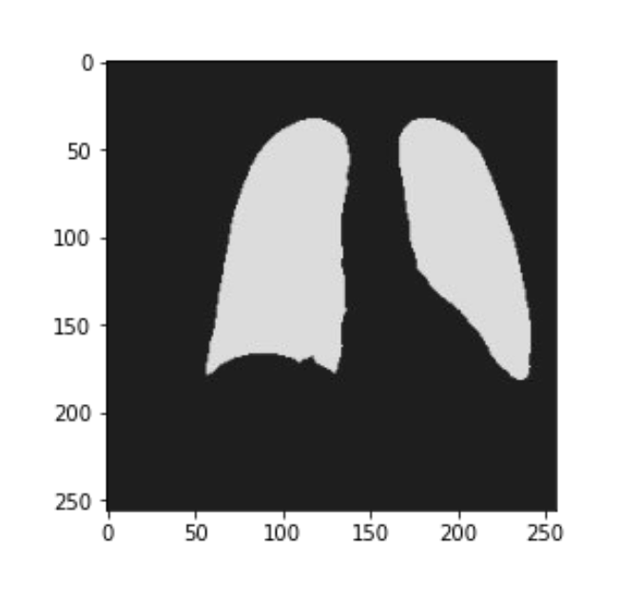
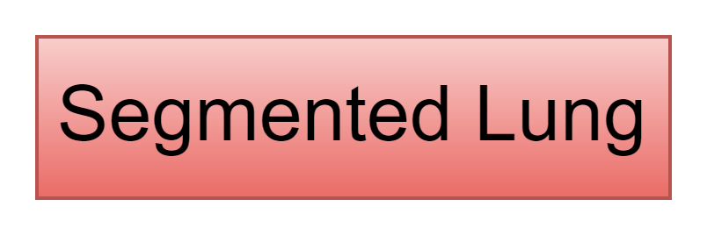
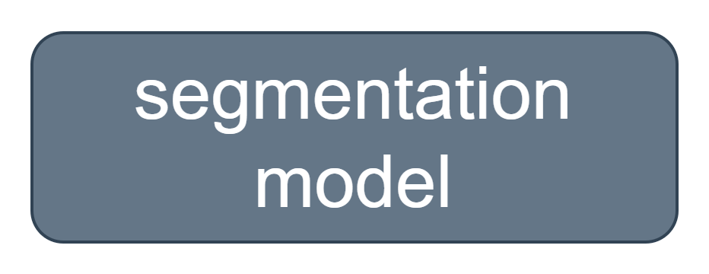
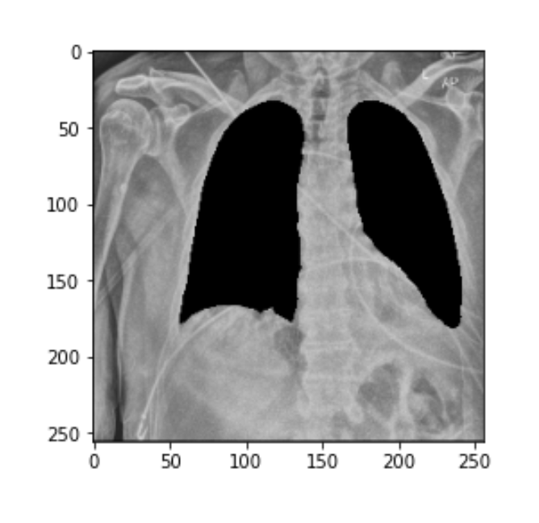

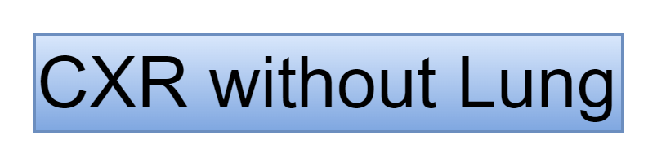
Background
the first is the task of segmenting the lungs.
the second is the task of classifying covid-19 with standard chest x-ray images, with only partial lungs in the image, without lungs in the image.
5

Slide 6
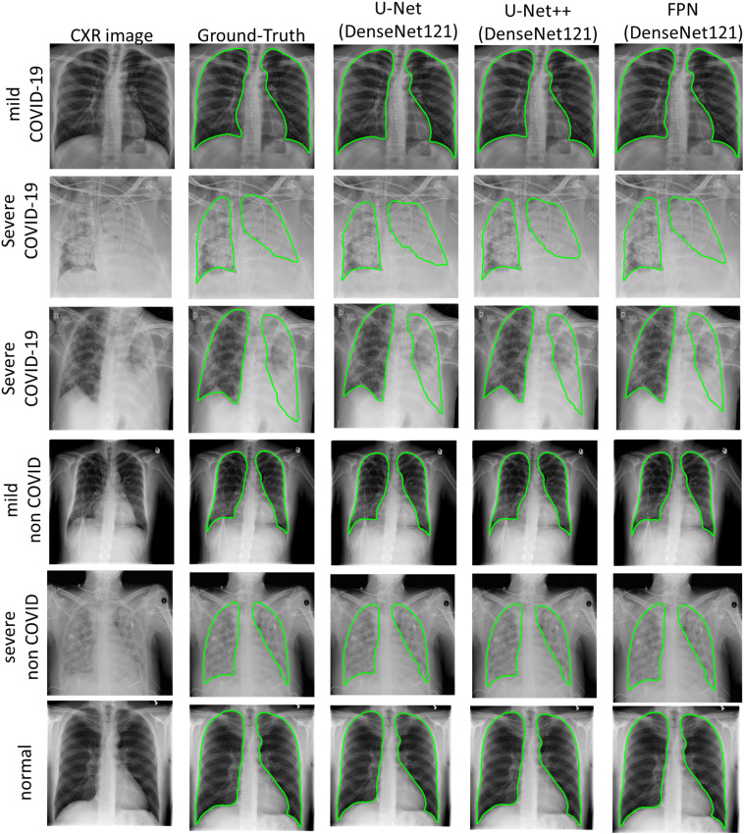
Related works
Segmentation
(1) A.M. Tahir et al., COVID-19 infection localization and severity grading from chestX-ray images, Computers in Biology and Medicine 139 (2021) 105002
6

Slide 7
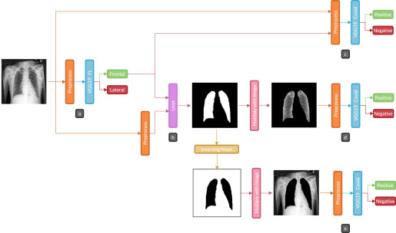
Related works
Classification
(2) Arias-Garzón, Daniel, et al. "COVID-19 detection in X-ray images using convolutional neural networks." Machine Learning with Applications 6 (2021): 100138.
7

Slide 8
Datasets
TRAIN LUNG SEGMENTATION:
COVID_QU_Ex consists of 33,920 chest X-ray (CXR) images including:
11,956 COVID-19
11,263 Non-COVID infections (Viral or Bacterial Pneumonia)
10,701 Normal
Ground-truth lung segmentation masks are provided for the entire dataset.
INFERENCE LUNG SEGMENTATION and CLASSIFICATION COVID-19:
COVIDx CXR-3 Dataset (update 06/02/2022) contains 29,986 CXR images
Type | COVID-19 Negative | COVID-19 Positive | Total
Train | 13992 | 15994 | 29986
Test | 200 | 200 | 400
8

Slide 9
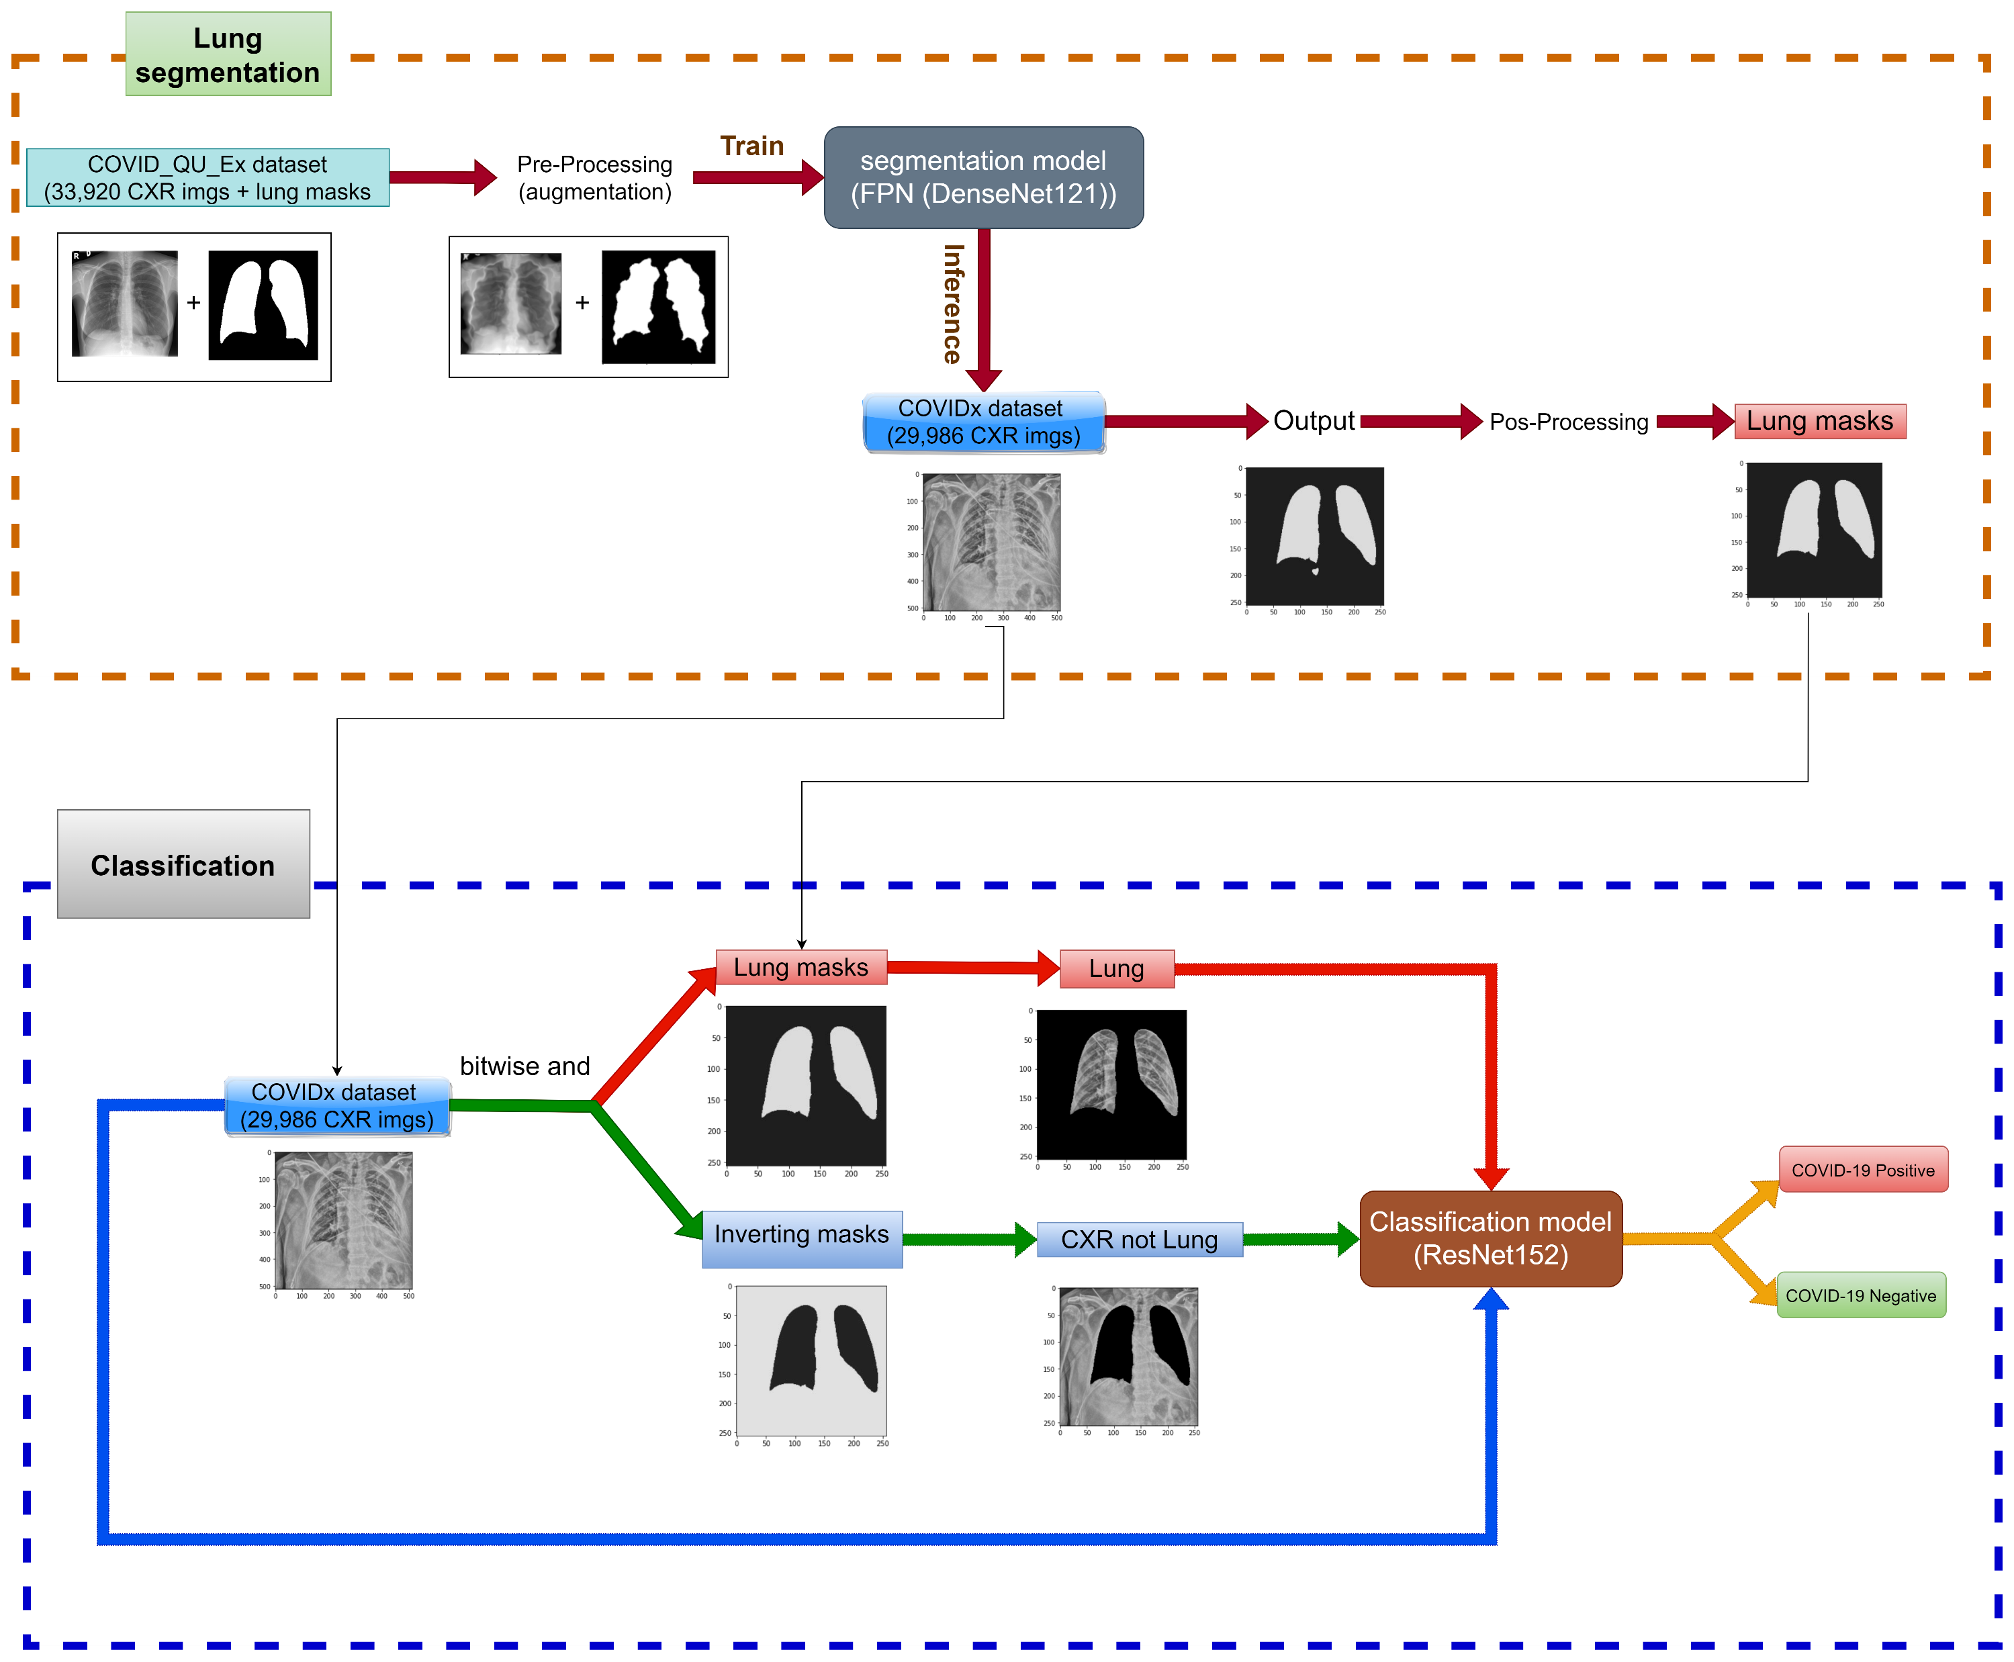
Methods
Pipeline
9

Slide 10
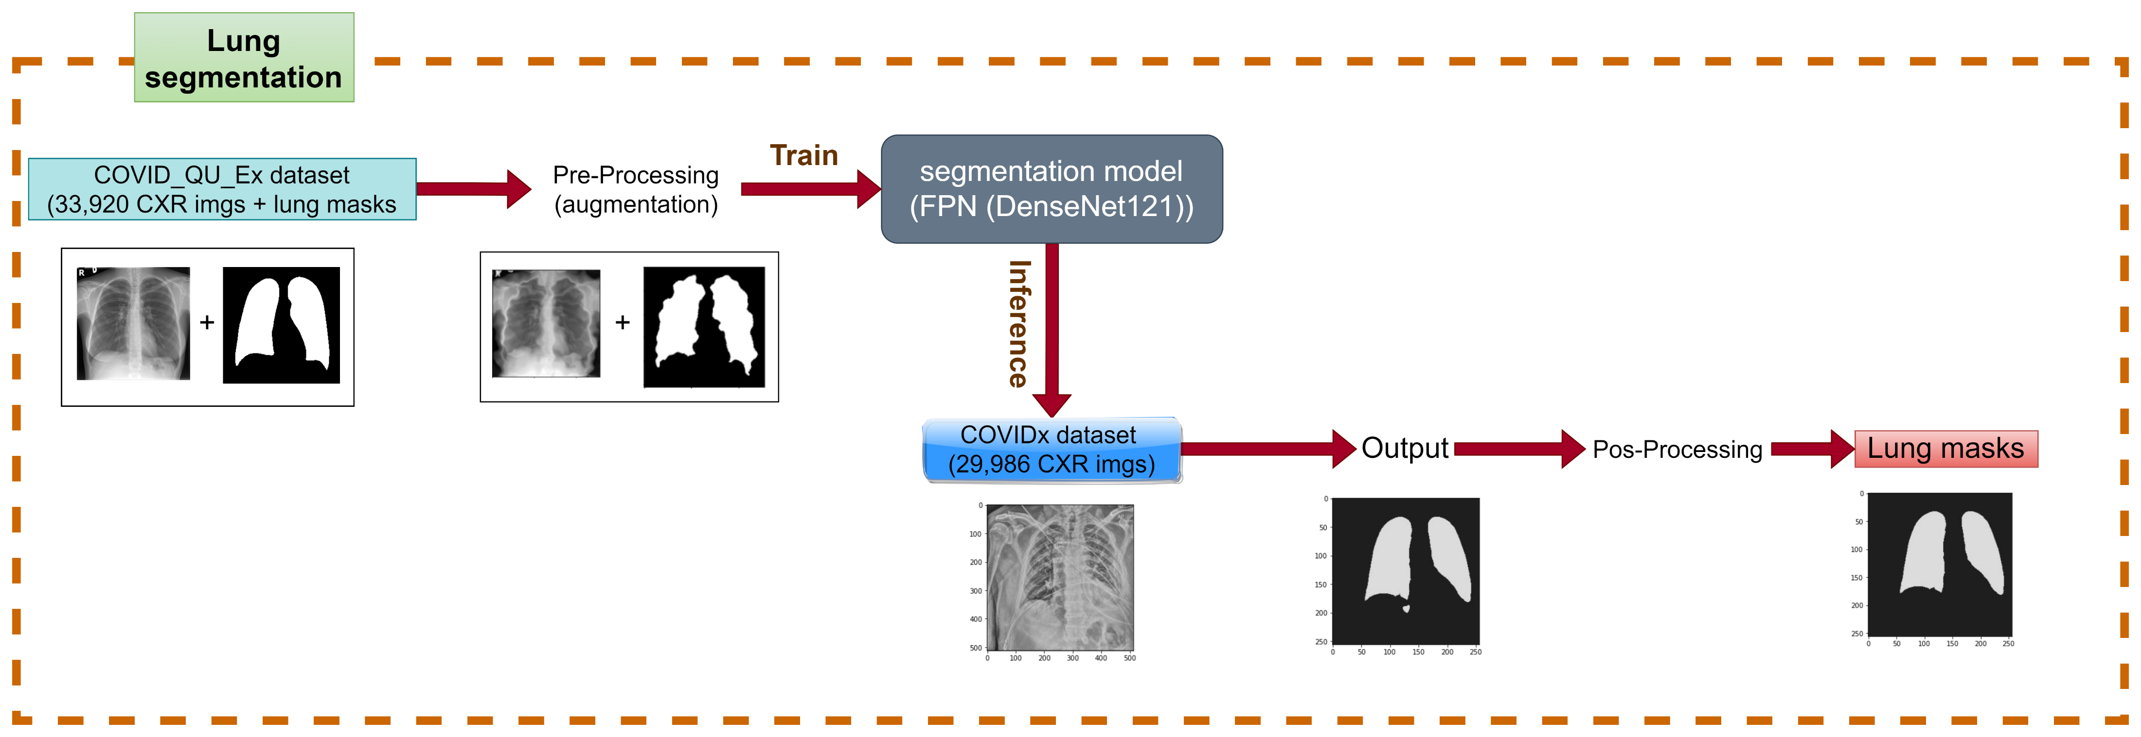
Methods
Phase 1: Lung segmentation
10

Slide 11
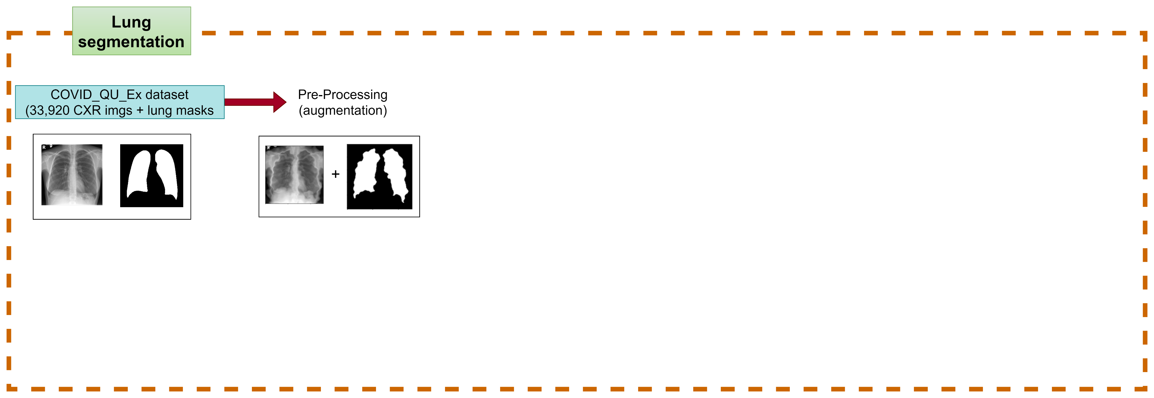
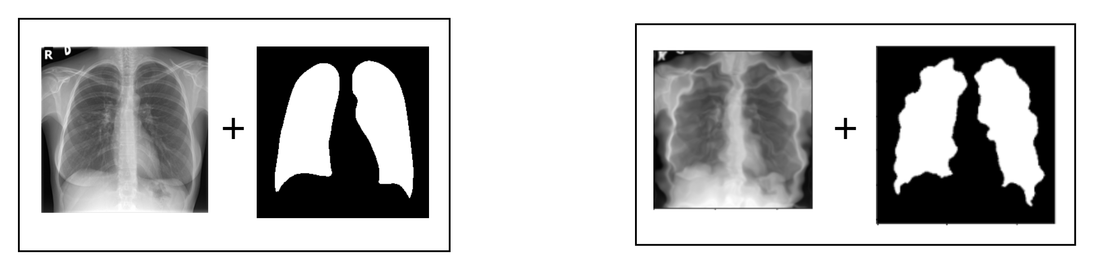

Methods
Phase 1: Lung segmentation
Pre-Processing (Augmentation): reads the data => resizes => compute mean and std => Horizontal Flip => Elastic Transform => Rotate => Normalize
11

Slide 12
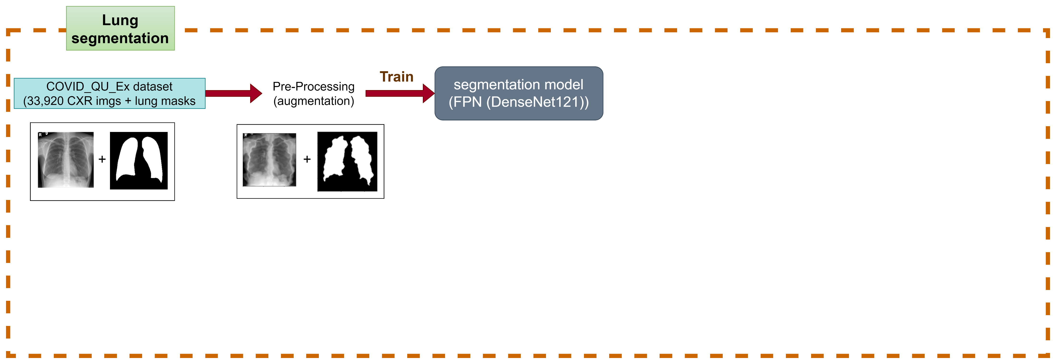
Methods
Phase 1: Lung segmentation
Pre-Processing (Augmentation): reads the data => resizes => compute mean and std => Horizontal Flip => Elastic Transform => Rotate => Normalize
Train: using segmentation_model_pytorch (FPN (DenseNet121) pretrained on ImageNet. Use comboloss (Dice + BCE + Focal ) to compare the output and ground truth
12

Slide 13
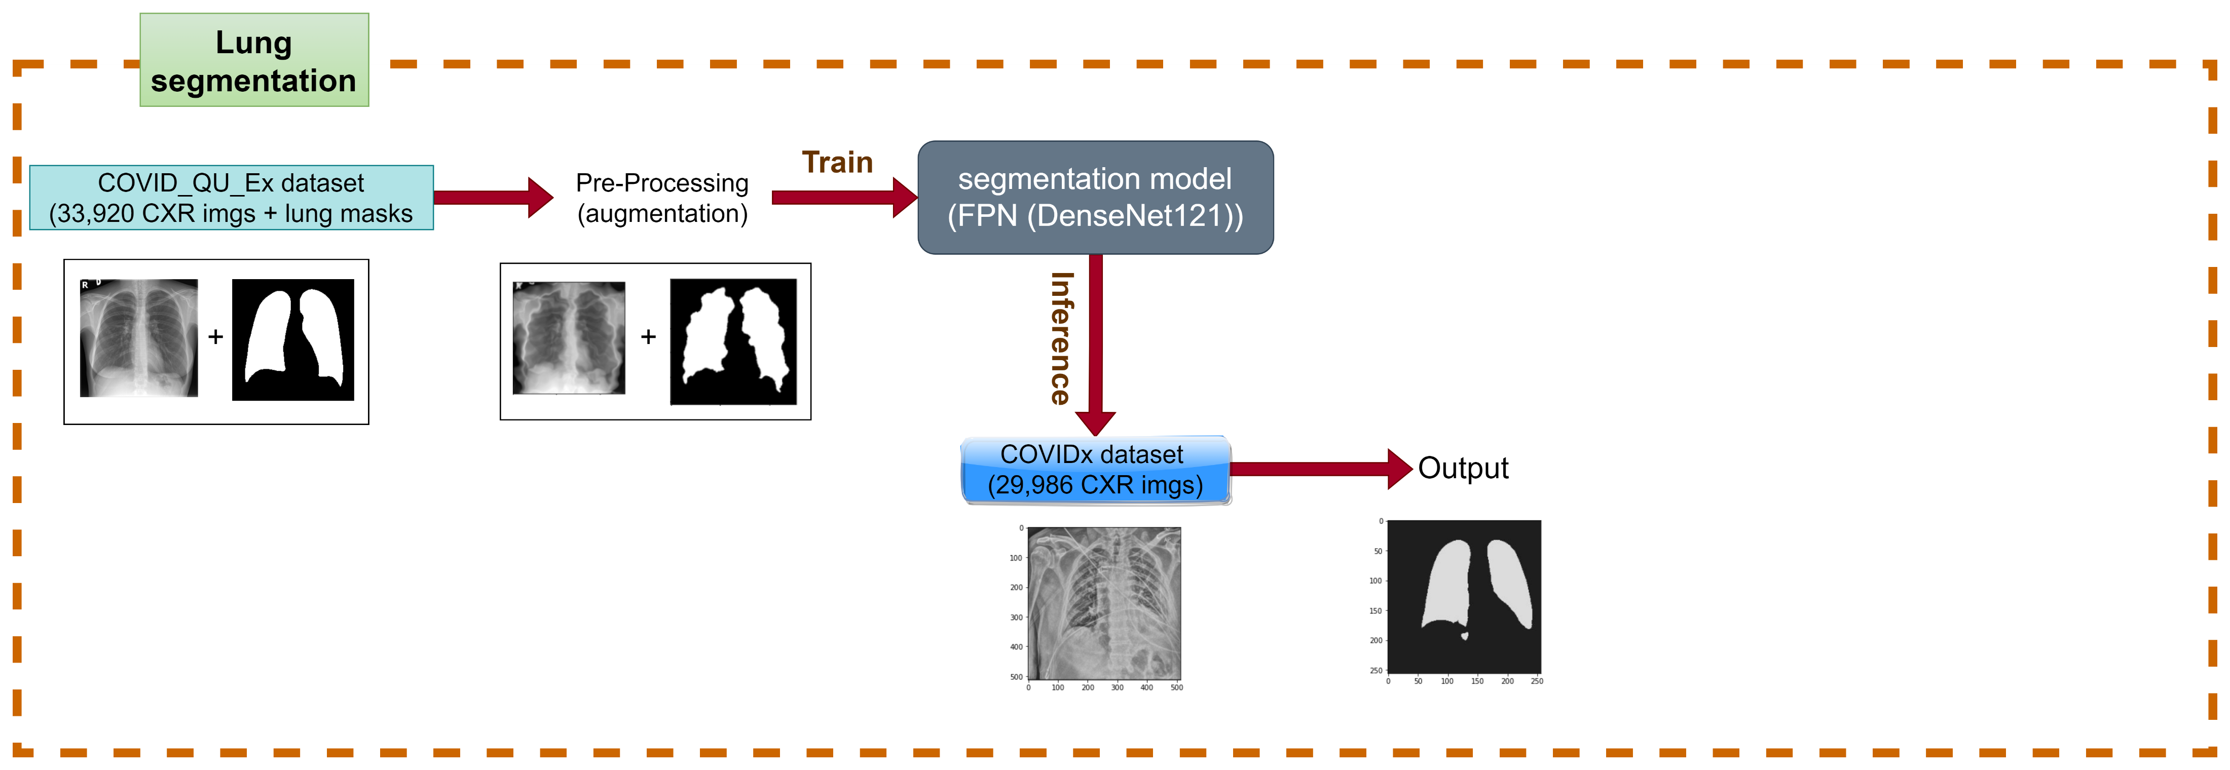
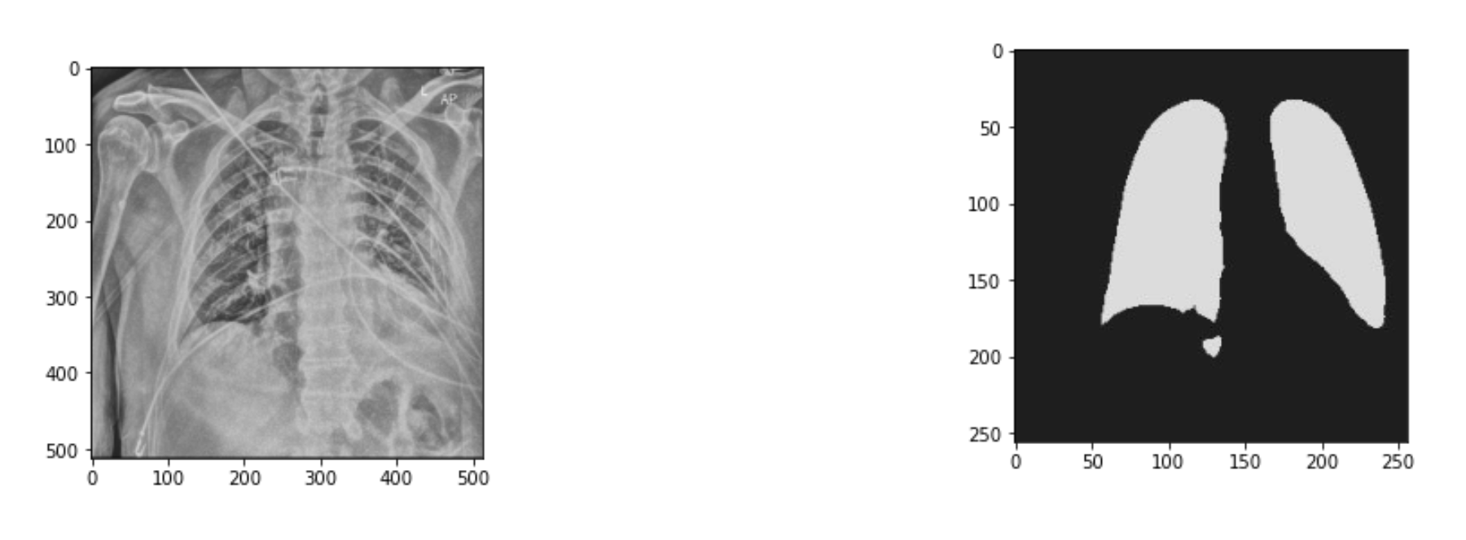
Methods
Phase 1: Lung segmentation
Pre-Processing (Augmentation): reads the data => resizes => compute mean and std => Horizontal Flip => Elastic Transform => Rotate => Normalize
Train: using segmentation_model_pytorch (FPN (DenseNet121) pretrained on ImageNet. Use comboloss (Dice + BCE + Focal ) to compare the output and ground truth
Inference: using FPN (DenseNet121) pretrained on COVID_QU_Ex dataset to create lung mask for COVIDx dataset
13

Slide 14

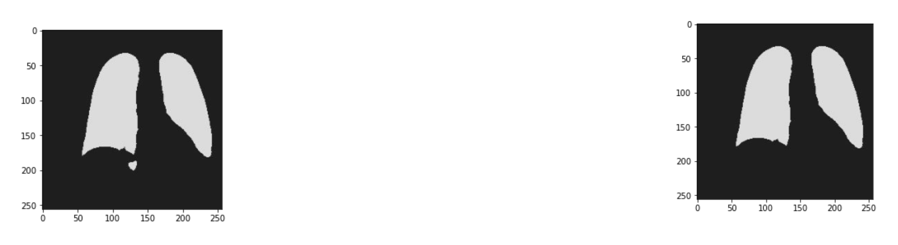
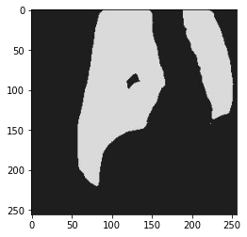

Methods
Phase 1: Lung segmentation
Pre-Processing (Augmentation): reads the data => resizes => compute mean and std => Horizontal Flip => Elastic Transform => Rotate => Normalize
Train: using segmentation_model_pytorch (FPN (DenseNet121) pretrained on ImageNet. Use comboloss (Dice + BCE + Focal ) to compare the output and ground truth
Inference: using FPN (DenseNet121) pretrained on COVID_QU_Ex dataset to create lung mask for COVIDx dataset
Pos-Processing: remove small objects and remove small holes
remove small objects
remove small holes
14

Slide 15
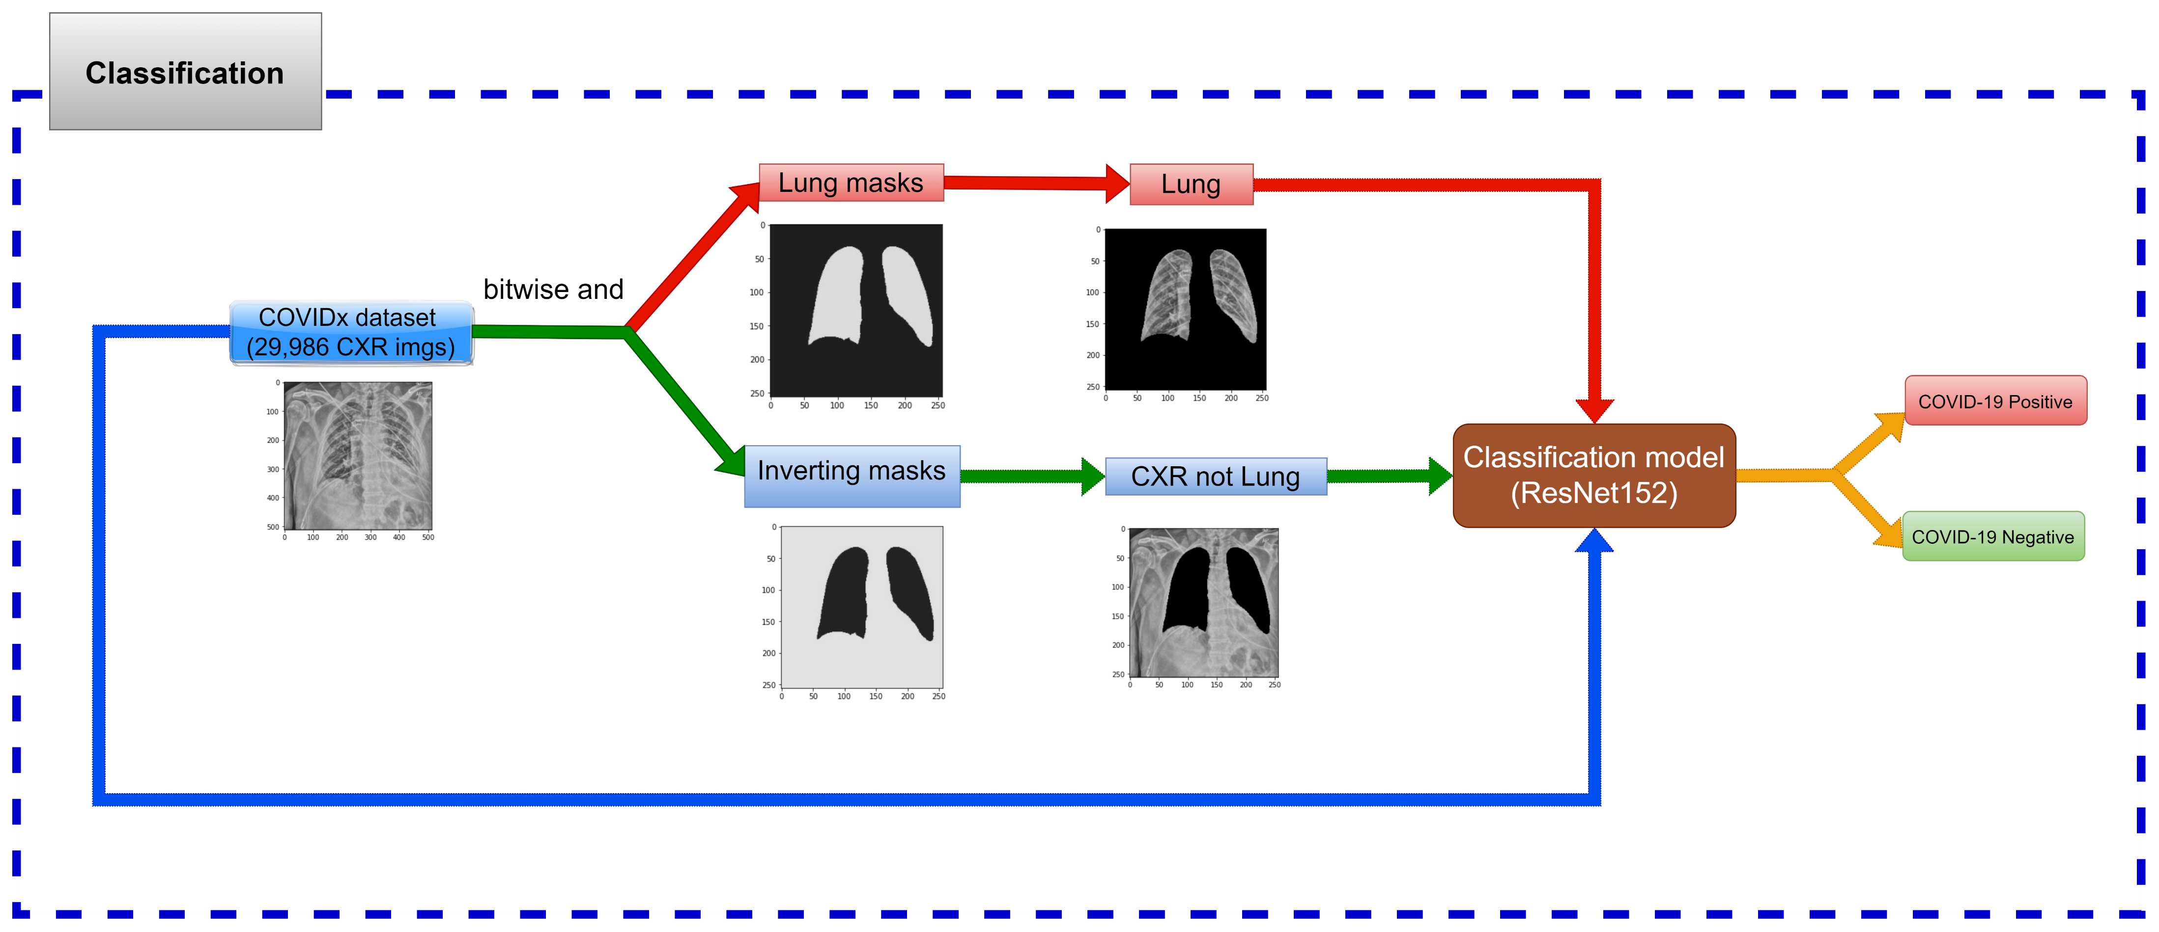
Methods
Phase 2: Covid-19 Classification
15

Slide 16
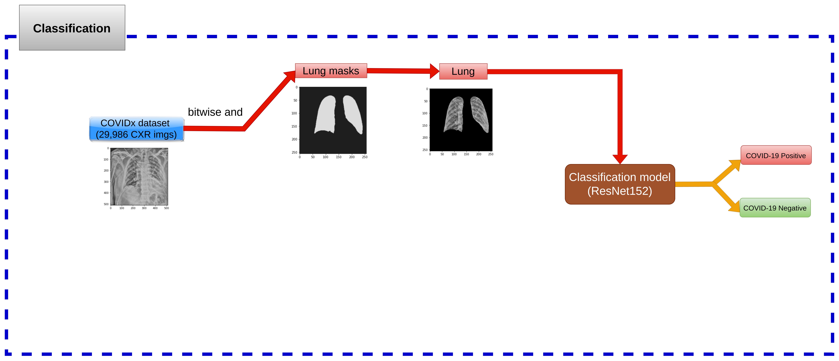
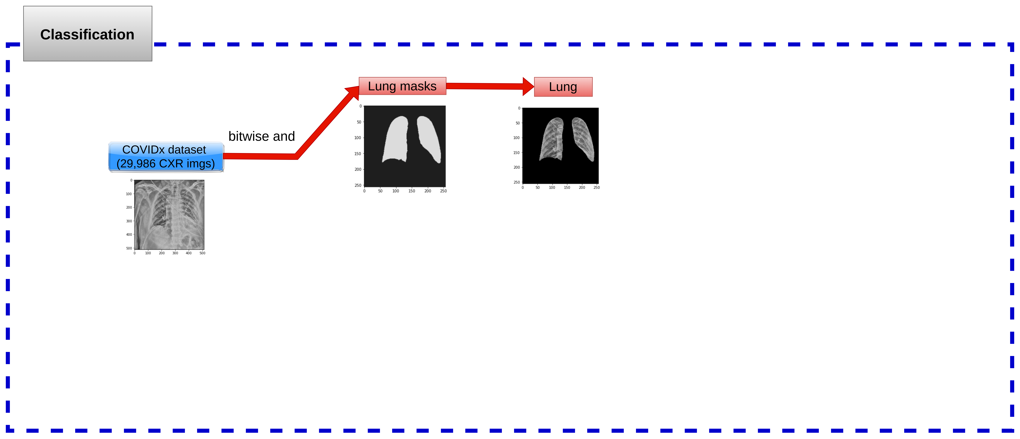


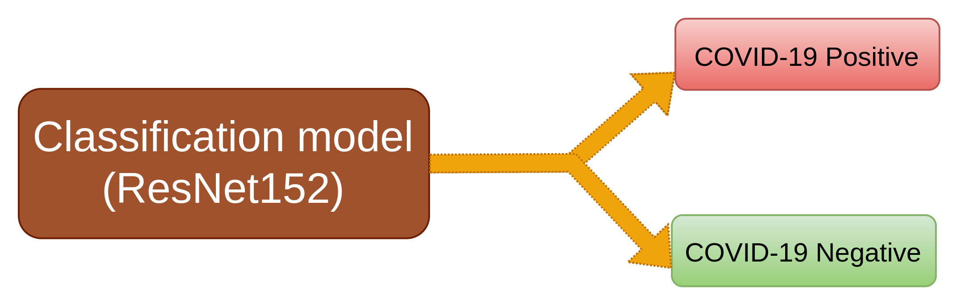


Methods
Phase 2: Covid-19 Classification
Segmented Lung: CXR (bitwise_and) Lung mask => Segmented Lung
=> Covid-19 classification
bitwise and
16

Slide 17
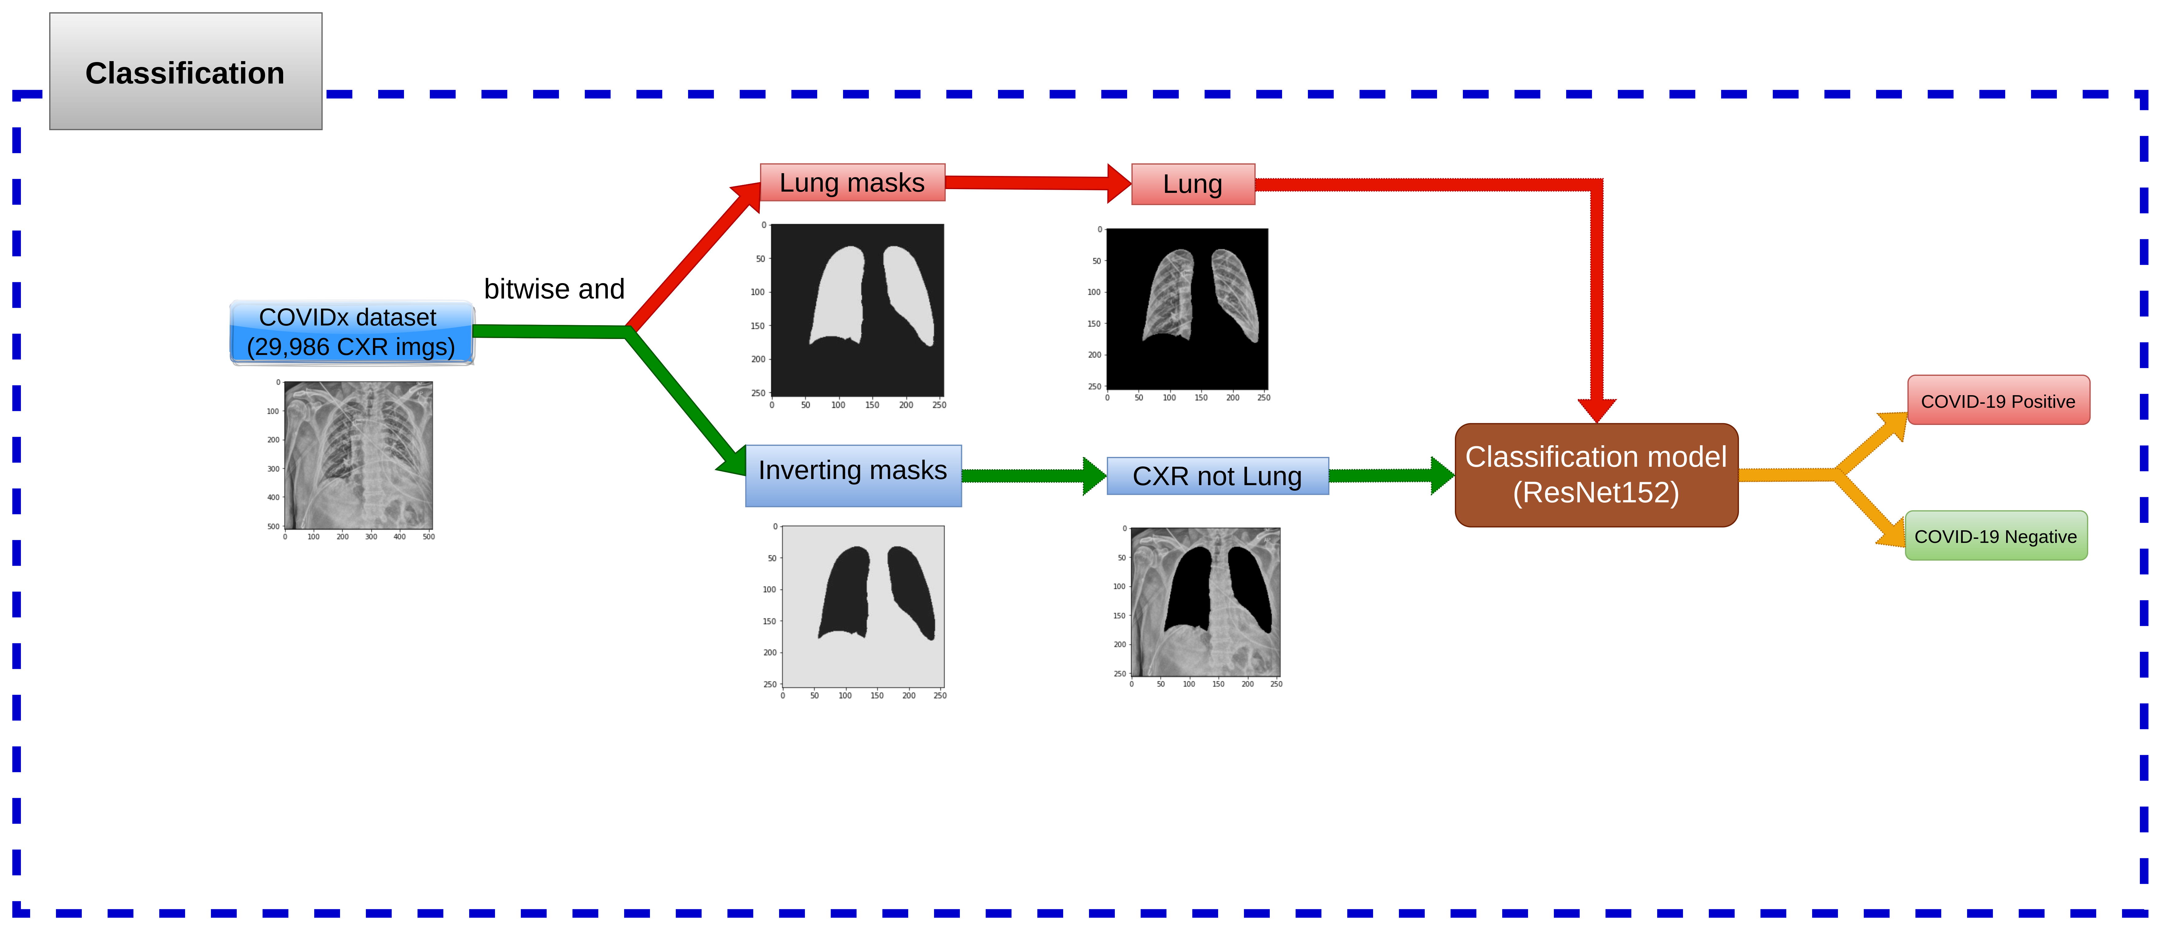

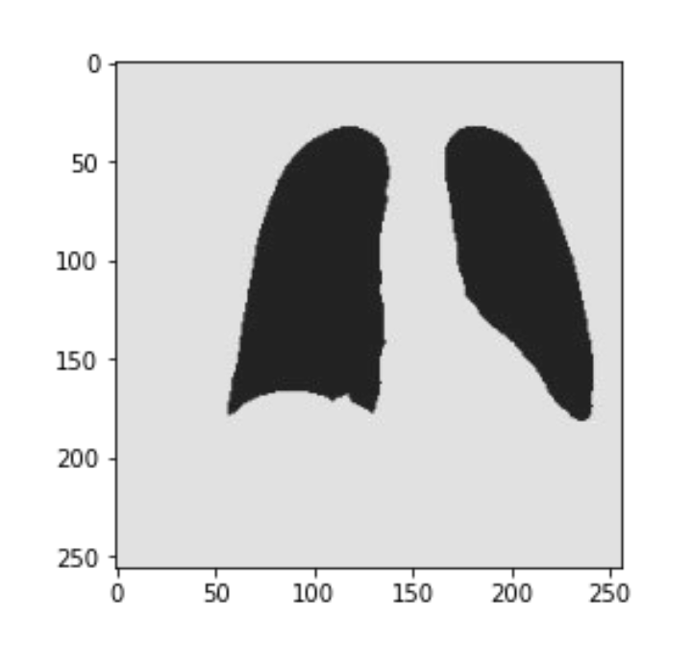
Methods
Phase 2: Covid-19 Classification
Segmented Lung: CXR (bitwise_and) Lung mask => Segmented Lung
=> Covid-19 classification
CXR without Lung: CXR bitwise_and Inverting mask => CXR without Lung
=> Covid-19 classification
bitwise and
17

Slide 18
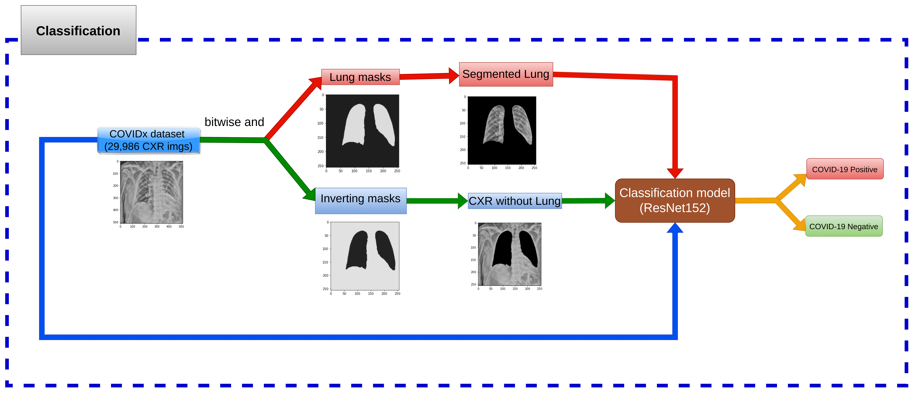
Methods
Phase 2: Covid-19 Classification
Segmented Lung: CXR (bitwise_and) Lung mask => Segmented Lung
=> Covid-19 classification
CXR without Lung: CXR bitwise_and Inverting mask => CXR without Lung
=> Covid-19 classification
CXR original: Covid-19 classification
18

Slide 19
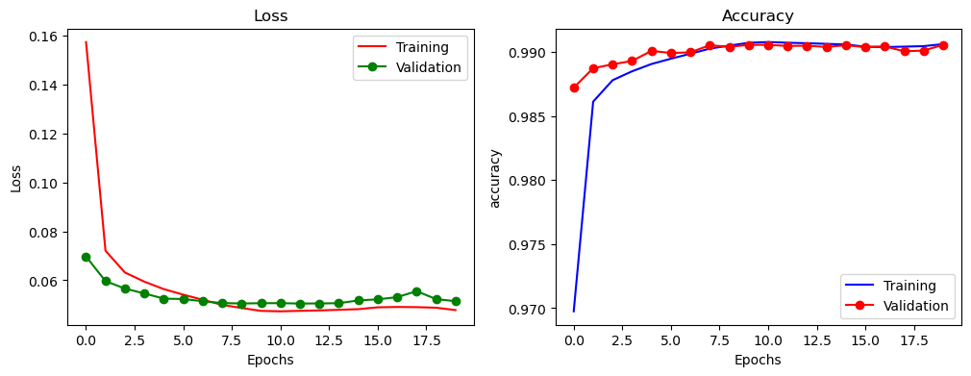
Experimental results (Lung Segmentation)
19

Slide 20
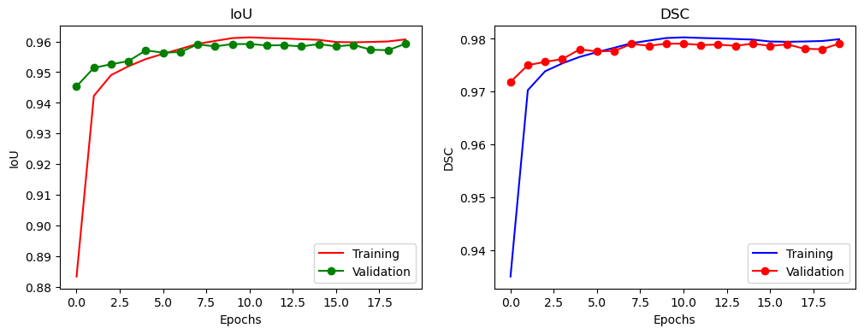
Experimental results (Lung Segmentation)
20

Slide 21
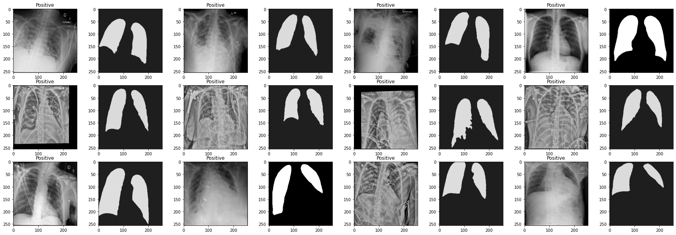
Experimental results (Lung Segmentation)
Inference:
21

Slide 22
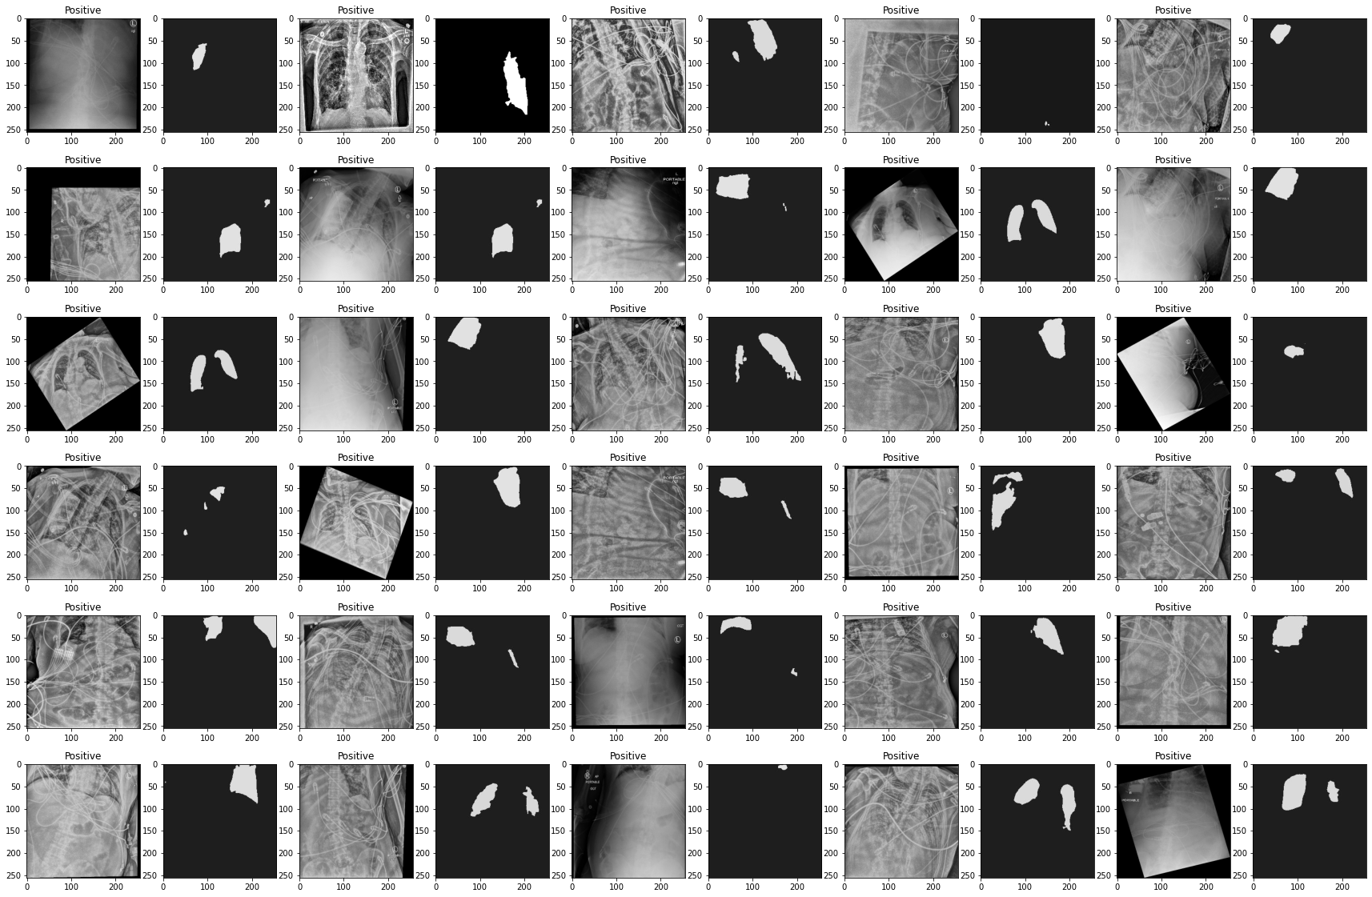
Experimental results (Lung Segmentation)
Inference: filter out images whose segmented area is less than 15% area of ​​the whole image
(30 images Covid-19 Positive)
22

Slide 23
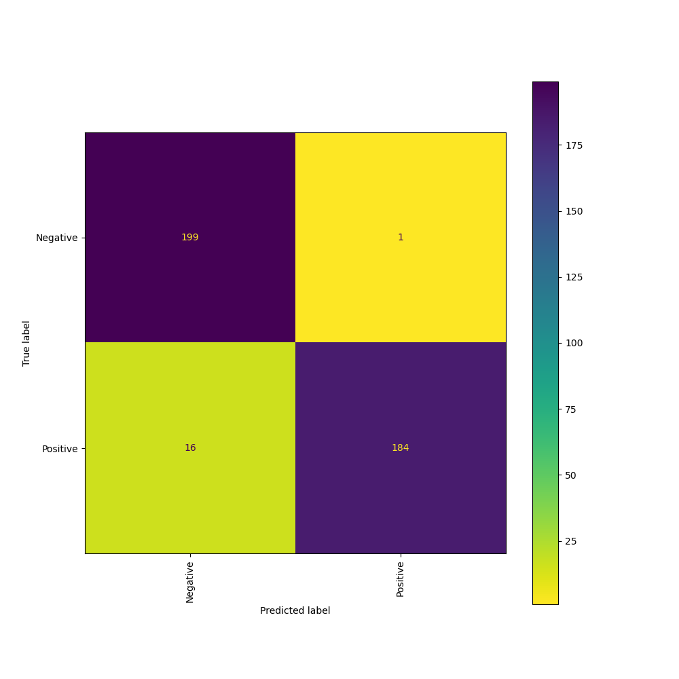
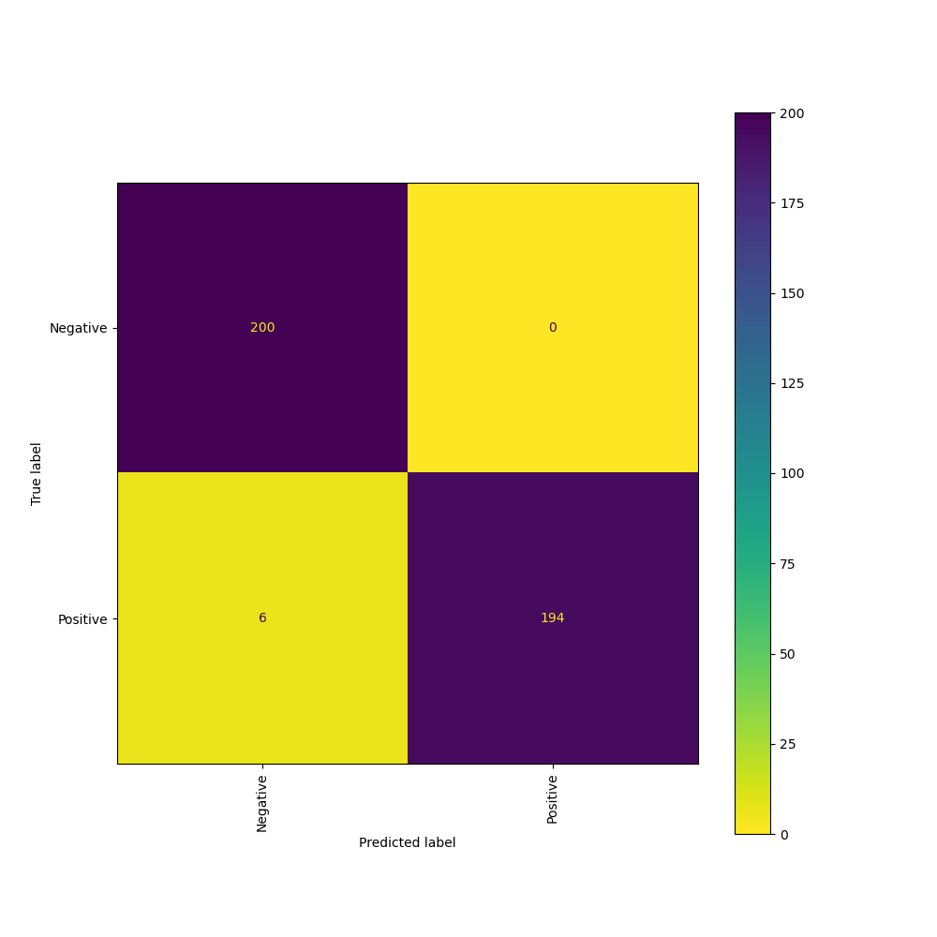
Experimental results (Classification on Grayscale / RGB images)
CXR_GRAYSCALE
CXR_RGB
23

Slide 24
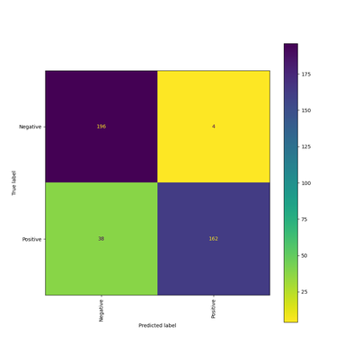
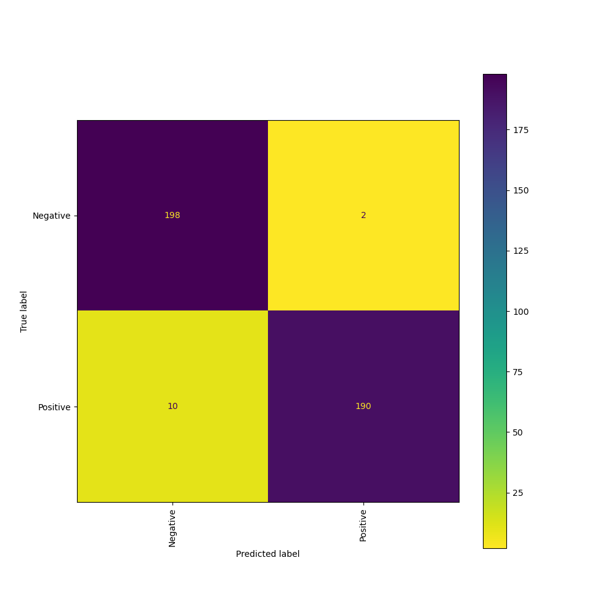
Experimental results (Classification on Grayscale / RGB images)
LUNG_GRAYSCALE
LUNG_RGB
24

Slide 25

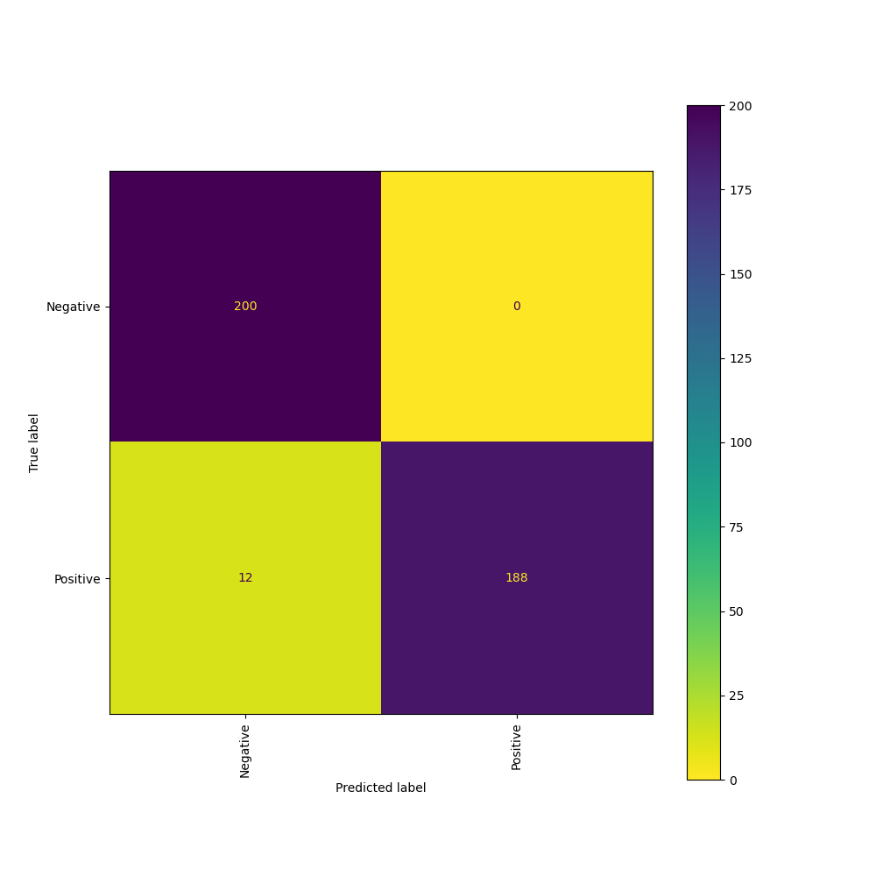
Experimental results (Classification on Grayscale / RGB images)
CXRnotLUNG_GRAYSCALE
CXRnotLUNG_RGB
25

Slide 26
Experimental results (Classification on mean/std)
Mean, std of ImageNet
Compute Mean, std

Slide 27
Experimental results (Classification on CXR / Lung / CXR not Lung images)
27

Slide 28
28

Slide 29
Conclusions
tạo ra lung mask cho COVIDx CXR3 dataset
Thuc hien classification (Covid-19 Negative/ Positive) treen COVIDx CXR3
Dat duoc hieu suat: ...
29

Slide 30


